Slide 1
Classical Bits and Gates - Part II
Tuesday, July 1, 2025
Dirac Notation

Slide 2
We can also represent the state of bits as vectors and gates as matrices and analyze circuits using linear algebra.

Slide 3
1 Bit…

Slide 4
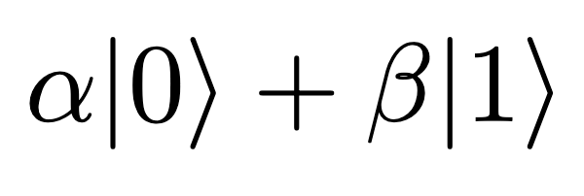
States as Vectors
We can write the state of our bit mathematically:
𝛂 is the greek letter “alpha” and 𝛃 is the greek letter “beta”.
𝛂 and 𝛃 tell us whether our bit state is a |0〉or |1〉.
If our bit state is |0〉, 𝛂 is 1 and 𝛃 is 0, so we just write |0〉.
If our bit state is |1〉, 𝛂 is 0 and 𝛃 is 1, so we just write |1〉.
Notes:
Overleaf symbols: https://www.overleaf.com/project/680fc324dcee7ba2c8379500

Slide 5
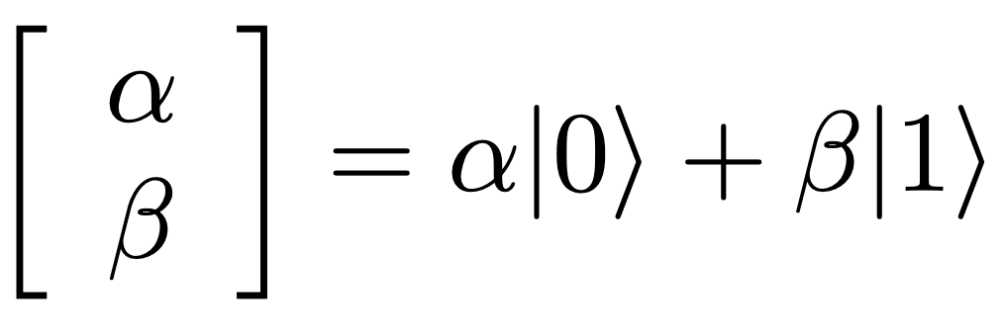
States as Vectors
We can also write our bit states as a vector of the 𝛂 and 𝛃 coefficients:
Notes:
Overleaf symbols: https://www.overleaf.com/project/680fc324dcee7ba2c8379500

Slide 6
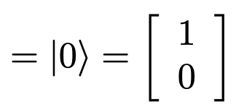
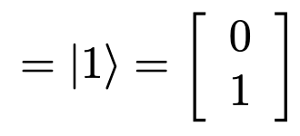
States as Vectors
We can also write our bit states as a vector of the 𝛂 and 𝛃 coefficients:
In this case, we can write the states |0〉 and |1〉 as:
Notes:
Overleaf symbols: https://www.overleaf.com/project/680fc324dcee7ba2c8379500

Slide 7
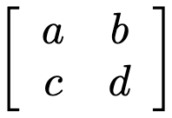
Gates as Matrices
We can mathematically represent gates as matrices:
Notes:
Overleaf symbols: https://www.overleaf.com/project/680fc324dcee7ba2c8379500

Slide 8
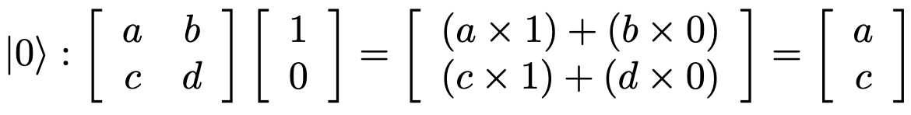
Gates as Matrices
We can mathematically represent gates as matrices:
When we operate on a bit with a gate, we write the gate to the left of the bit:
Gate operating on a
Notes:
Overleaf symbols: https://www.overleaf.com/project/680fc324dcee7ba2c8379500

Slide 9
Gates as Matrices
We can mathematically represent gates as matrices:
When we operate on a bit with a gate, we write the gate to the left of the bit:
Gate operating on a
Notes:
Overleaf symbols: https://www.overleaf.com/project/680fc324dcee7ba2c8379500

Slide 10
Gates as Matrices
We can mathematically represent gates as matrices:
When we operate on a bit with a gate, we write the gate to the left of the bit:
Gate operating on a
Notes:
Overleaf symbols: https://www.overleaf.com/project/680fc324dcee7ba2c8379500

Slide 11
Gates as Matrices
We can mathematically represent gates as matrices:
When we operate on a bit with a gate, we write the gate to the left of the bit:
Gate operating on a
Notes:
Overleaf symbols: https://www.overleaf.com/project/680fc324dcee7ba2c8379500

Slide 12
Gates as Matrices
We can mathematically represent gates as matrices:
When we operate on a bit with a gate, we write the gate to the left of the bit:
Gate operating on a
Notes:
Overleaf symbols: https://www.overleaf.com/project/680fc324dcee7ba2c8379500

Slide 13
Gates as Matrices
We can mathematically represent gates as matrices:
When we operate on a bit with a gate, we write the gate to the left of the bit:
Gate operating on a
Notes:
Overleaf symbols: https://www.overleaf.com/project/680fc324dcee7ba2c8379500

Slide 14
Gates as Matrices
We can mathematically represent gates as matrices:
When we operate on a bit with a gate, we write the gate to the left of the bit:
Gate operating on a
Notes:
Overleaf symbols: https://www.overleaf.com/project/680fc324dcee7ba2c8379500

Slide 15
Gates as Matrices
We can mathematically represent gates as matrices:
When we operate on a bit with a gate, we write the gate to the left of the bit:
Gate operating on a
Notes:
Overleaf symbols: https://www.overleaf.com/project/680fc324dcee7ba2c8379500

Slide 16
Gates as Matrices
We can mathematically represent gates as matrices:
When we operate on a bit with a gate, we write the gate to the left of the bit:
Gate operating on a
Notes:
Overleaf symbols: https://www.overleaf.com/project/680fc324dcee7ba2c8379500

Slide 17
Gates as Matrices
We can mathematically represent gates as matrices:
When we operate on a bit with a gate, we write the gate to the left of the bit:
Gate operating on a
Notes:
Overleaf symbols: https://www.overleaf.com/project/680fc324dcee7ba2c8379500

Slide 18
Gates as Matrices
We can mathematically represent gates as matrices:
When we operate on a bit with a gate, we write the gate to the left of the bit:
Gate operating on a
Notes:
Overleaf symbols: https://www.overleaf.com/project/680fc324dcee7ba2c8379500

Slide 19
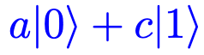
Gates as Matrices
We can mathematically represent gates as matrices:
When we operate on a bit with a gate, we write the gate to the left of the bit:
Gate operating on a
We can also rewrite this state as
Notes:
Overleaf symbols: https://www.overleaf.com/project/680fc324dcee7ba2c8379500

Slide 20
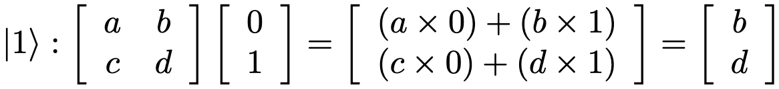

Gates as Matrices
We can mathematically represent gates as matrices:
When we operate on a bit with a gate, we write the gate to the left of the bit:
Gate operating on a
Notes:
Overleaf symbols: https://www.overleaf.com/project/680fc324dcee7ba2c8379500

Slide 21

Gates as Matrices
We can mathematically represent gates as matrices:
When we operate on a bit with a gate, we write the gate to the left of the bit:
Gate operating on a
Notes:
Overleaf symbols: https://www.overleaf.com/project/680fc324dcee7ba2c8379500

Slide 22
Gates as Matrices
We can mathematically represent gates as matrices:
When we operate on a bit with a gate, we write the gate to the left of the bit:
Gate operating on a
Notes:
Overleaf symbols: https://www.overleaf.com/project/680fc324dcee7ba2c8379500

Slide 23
Gates as Matrices
We can mathematically represent gates as matrices:
When we operate on a bit with a gate, we write the gate to the left of the bit:
Gate operating on a
Notes:
Overleaf symbols: https://www.overleaf.com/project/680fc324dcee7ba2c8379500

Slide 24
Gates as Matrices
We can mathematically represent gates as matrices:
When we operate on a bit with a gate, we write the gate to the left of the bit:
Gate operating on a
Notes:
Overleaf symbols: https://www.overleaf.com/project/680fc324dcee7ba2c8379500

Slide 25
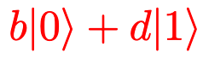
Gates as Matrices
We can mathematically represent gates as matrices:
When we operate on a bit with a gate, we write the gate to the left of the bit:
Gate operating on a
We can also rewrite this state as
Notes:
Overleaf symbols: https://www.overleaf.com/project/680fc324dcee7ba2c8379500

Slide 26
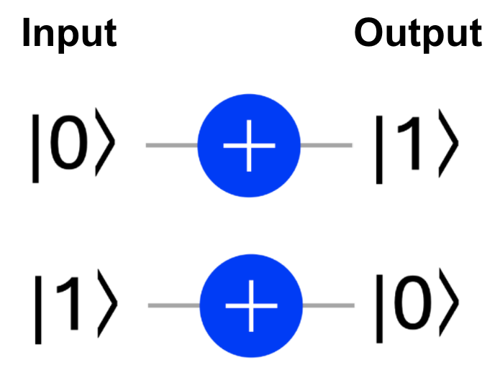
Review: NOT Gate
The NOT gate changes the value of the input bit.

Slide 27
What matrix represents the NOT gate?

Slide 28
What matrix represents the NOT gate?
In = |0>
In = |1>
Tells us what we get if we operate on a 0
Tells us what we get if we operate on a 1

Slide 29
What matrix represents the NOT gate?
In = |0>
In = |1>
Tells us what we get if we operate on a 0
Tells us what we get if we operate on a 1
0 | 1
1 | 0

Slide 30
What matrix represents the NOT gate?
Or, we can solve this more mathematically…

Slide 31
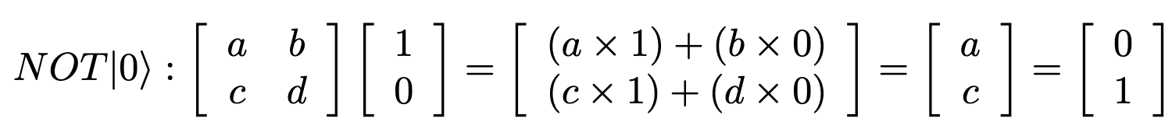
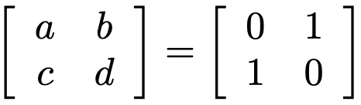
What matrix represents the NOT gate?
Therefore, for the NOT gate

Slide 32
What matrix represents the NOT gate?
Therefore, for the NOT gate

Slide 33
What matrix represents the NOT gate?
Therefore, for the NOT gate

Slide 34
What matrix represents the NOT gate?
Therefore, for the NOT gate

Slide 35
What matrix represents the NOT gate?
Therefore, for the NOT gate

Slide 36
What matrix represents the NOT gate?
Therefore, for the NOT gate
?
?

Slide 37
What matrix represents the NOT gate?
Therefore, for the NOT gate
?
?

Slide 38
What matrix represents the NOT gate?
Therefore, for the NOT gate
?
?

Slide 39
What matrix represents the NOT gate?
Therefore, for the NOT gate
?
?

Slide 40
What matrix represents the NOT gate?
Therefore, for the NOT gate
?
?

Slide 41
What matrix represents the NOT gate?
Therefore, for the NOT gate
?
?

Slide 42
What matrix represents the NOT gate?
Therefore, for the NOT gate

Slide 43
>1 Bit…

Slide 44
States as Vectors
For two bits, we can write its state as a vector of the FOUR possible outcomes:

Slide 45
States as Vectors
For two bits, we can write its state as a vector of the FOUR possible outcomes:
|00⟩, |01⟩, |10⟩, |11⟩

Slide 46
States as Vectors
For two bits, we can write its state as a vector of the FOUR possible outcomes:
|00⟩, |01⟩, |10⟩, |11⟩
Where does this come from???
This is called a tensor product, which we write as
|0⟩⨂|0⟩ = |00⟩
|0⟩⨂|1⟩ = |01⟩
|1⟩⨂|0⟩ = |10⟩
|1⟩⨂|1⟩ = |11⟩

Slide 47
States as Vectors
For two bits, we can write its state as a vector of the FOUR possible outcomes:
|00⟩, |01⟩, |10⟩, |11⟩
We can also write these tensor products as vectors:
|00⟩ |01⟩ |10⟩ |11⟩
1
0
0
0
0
1
0
0
0
0
1
0
0
0
0
1

Slide 48
States as Vectors
For two bits, we can write its state as a vector of the FOUR possible outcomes:
|00⟩, |01⟩, |10⟩, |11⟩
We can also write these tensor products as vectors:
|00⟩ |01⟩ |10⟩ |11⟩
Here’s how I like to think of these vectors… Each row answers
“is it a |00⟩?”
“is it a |01⟩?”
“is it a |10⟩?”
“is it a |11⟩?”
1
0
0
0
0
1
0
0
0
0
1
0
0
0
0
1

Slide 49
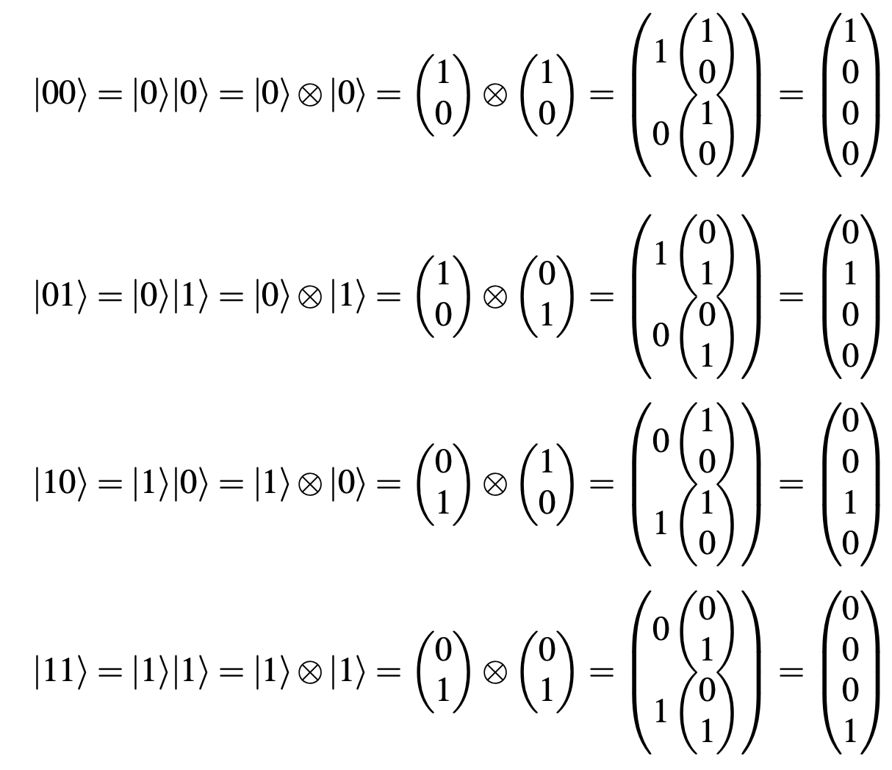
States as Vectors
The mathy way of figuring out what vector represents multiple bits is called the Kronecker product:

Slide 50
States as Vectors
How would we write the vector for 3 bits in the state |010⟩?

Slide 51
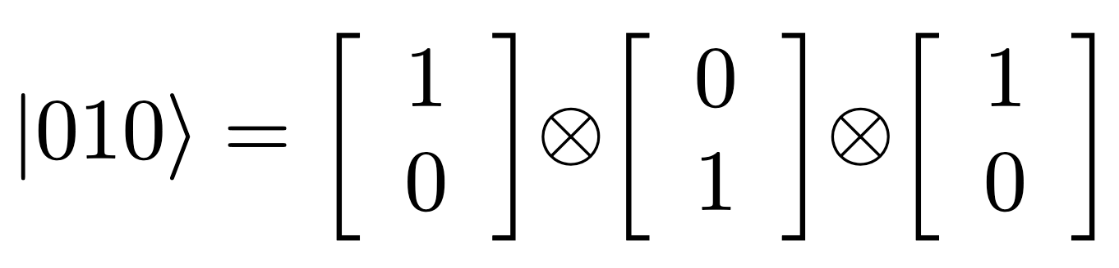
States as Vectors
How would we write the vector for 3 bits in the state |010⟩?
Answer:

Slide 52
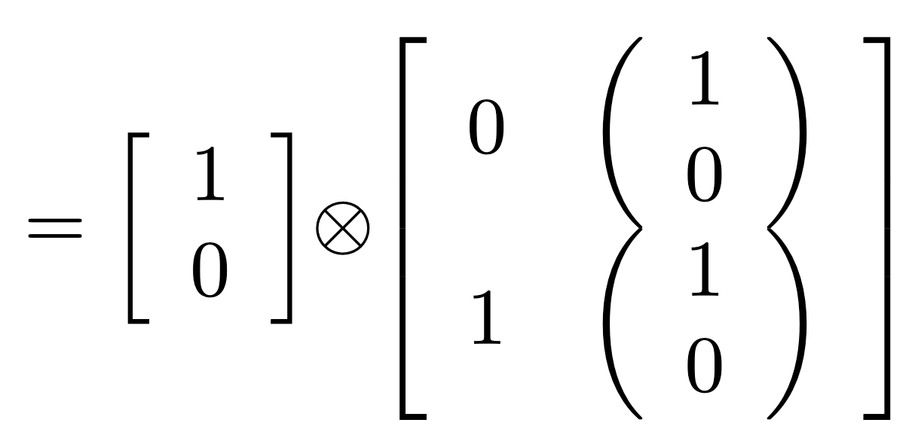
States as Vectors
How would we write the vector for 3 bits in the state |010⟩?
Answer:

Slide 53
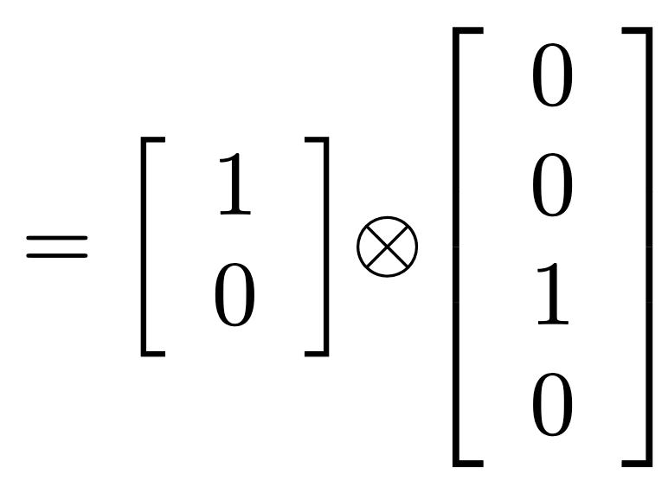
States as Vectors
How would we write the vector for 3 bits in the state |010⟩?
Answer:

Slide 54
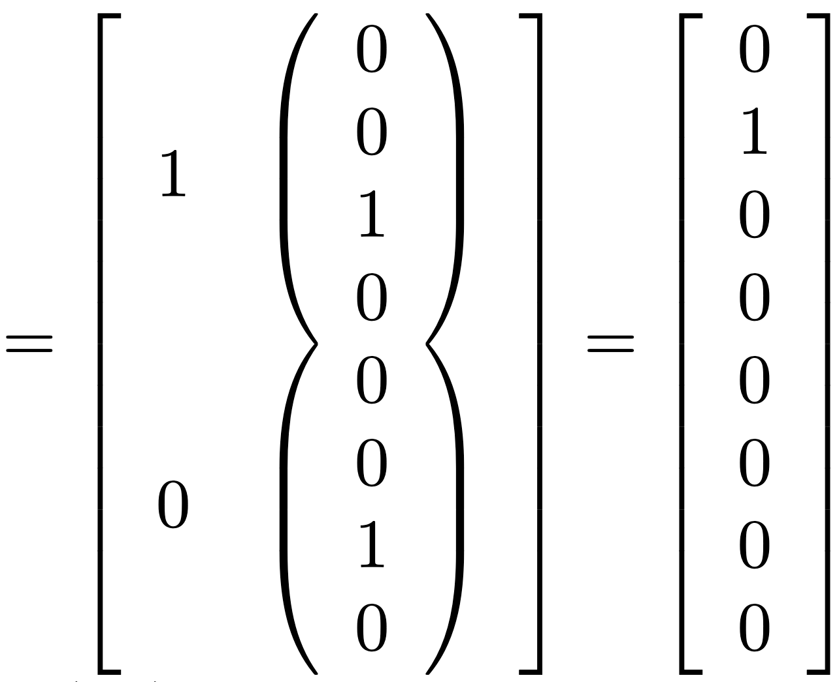
States as Vectors
How would we write the vector for 3 bits in the state |010⟩?
Answer:

Slide 55
2 Bit Gates
as Matrices

Slide 56
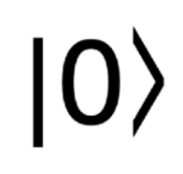
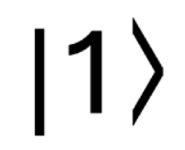
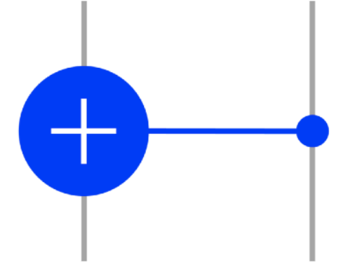
Review: CNOT Gate
Target
Target
Input Output
Input Output
Control
Control
Target
Target
Input Output
Input Output
Control
Control
If the control bit is 1, the target bit flips to the other value.

Slide 57
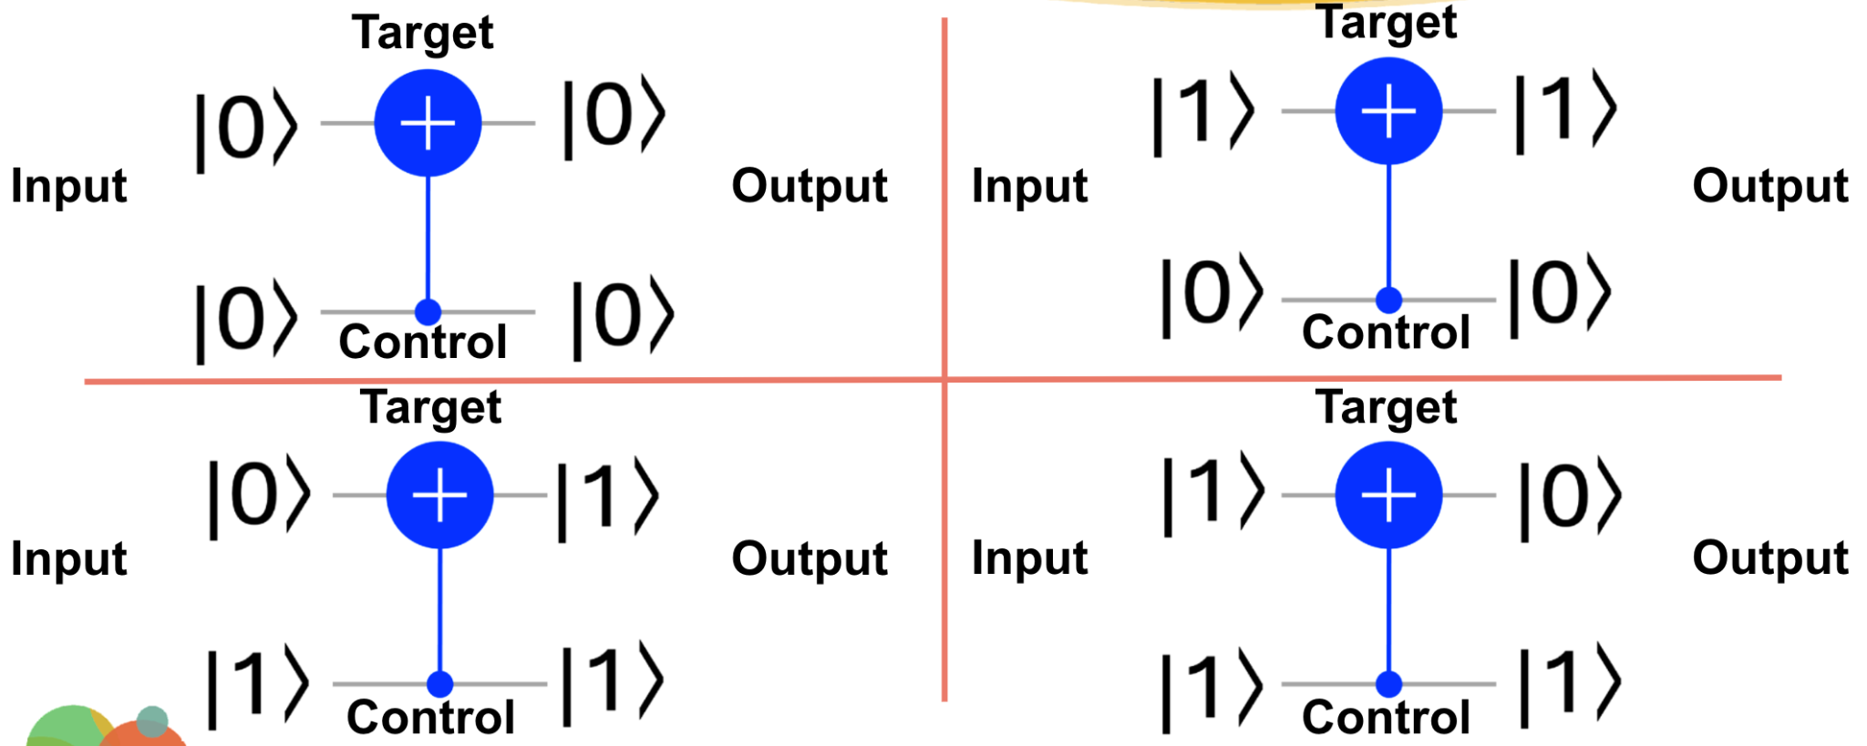
What matrix represents CNOT?
NOTE: The top bit is always represented by the rightmost number. In the case to the right, the bottom bit is the control bit, so the left most number represents the control bit.
In = |00>
In = |01>
In = |10>
In = |11>

Slide 58
What matrix represents CNOT?
NOTE: The top bit is always represented by the rightmost number. In the case to the right, the bottom bit is the control bit, so the left most number represents the control bit.
In = |00>
In = |01>
In = |10>
In = |11>
1 | 0 | 0 | 0
0 | 1 | 0 | 0
0 | 0 | 0 | 1
0 | 0 | 1 | 0

Slide 59
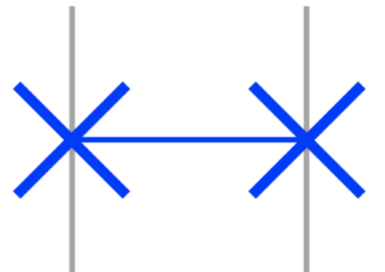
Review: SWAP Gate
Input Output
Input Output
Input Output
Input Output
The SWAP gate switches the positions of the two inputs.

Slide 60
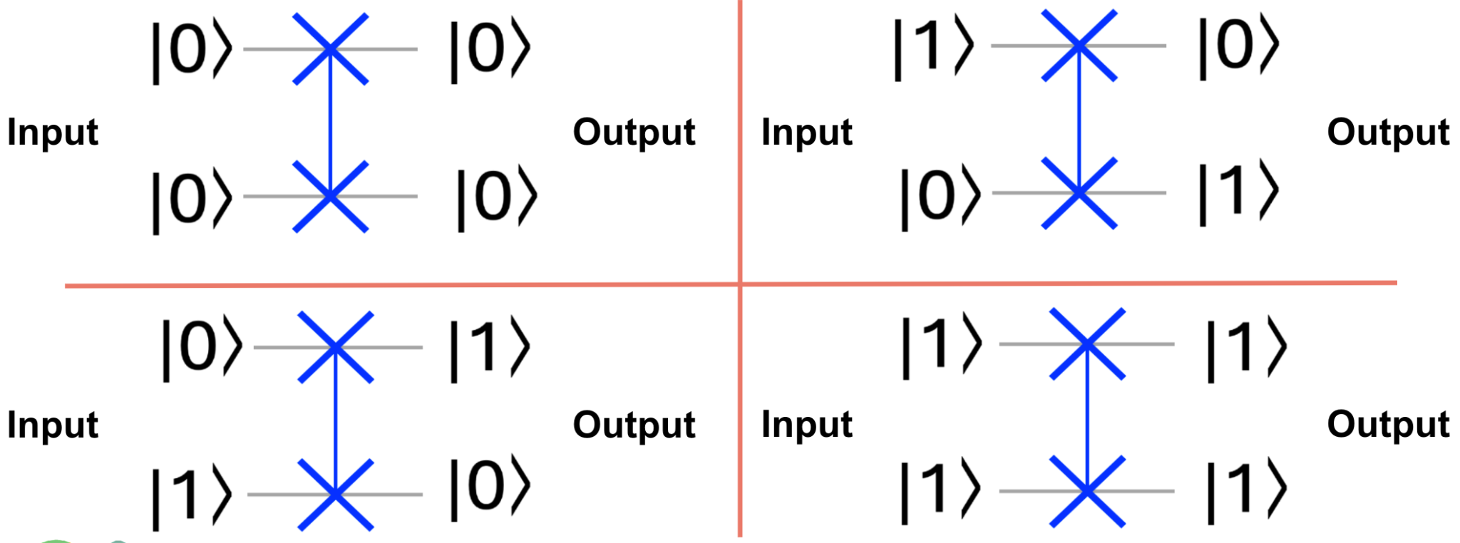
What matrix represents SWAP?
NOTE: The top bit is always represented by the rightmost number.
In = |00>
In = |01>
In = |10>
In = |11>

Slide 61
What matrix represents SWAP?
NOTE: The top bit is always represented by the rightmost number.
In = |00>
In = |01>
In = |10>
In = |11>
1 | 0 | 0 | 0
0 | 0 | 1 | 0
0 | 1 | 0 | 0
0 | 0 | 0 | 1

Slide 62
Math-ing a Circuit

Slide 63

Circuits with Linear Algebra
How would we use linear algebra to determine the outcome of this circuit:

Slide 64
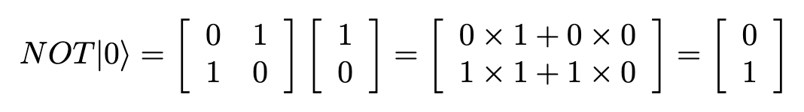
Circuits with Linear Algebra
How would we use linear algebra to determine the outcome of this circuit:

Slide 65
Circuits with Linear Algebra
How would we use linear algebra to determine the outcome of this circuit:

Slide 66
Circuits with Linear Algebra
How would we use linear algebra to determine the outcome of this circuit:

Slide 67
Circuits with Linear Algebra
How would we use linear algebra to determine the outcome of this circuit:

Slide 68
Circuits with Linear Algebra
How would we use linear algebra to determine the outcome of this circuit:

Slide 69
Math-ing a Harder Circuit

Slide 70
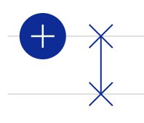
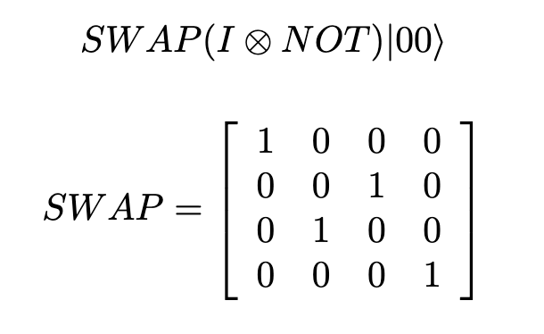
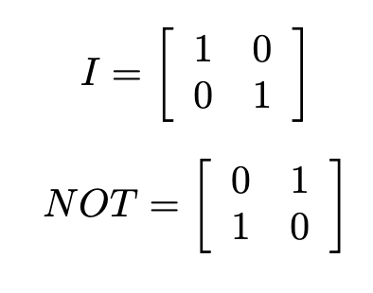
Circuits with Linear Algebra
How would we use linear algebra to determine the outcome of this circuit:

Slide 71
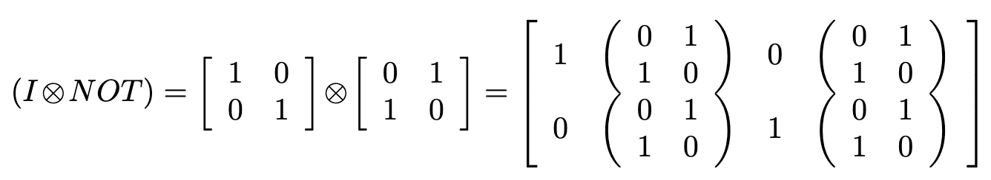
Circuits with Linear Algebra
How would we use linear algebra to determine the outcome of this circuit:

Slide 72
Circuits with Linear Algebra
How would we use linear algebra to determine the outcome of this circuit:

Slide 73
Circuits with Linear Algebra
How would we use linear algebra to determine the outcome of this circuit:

Slide 74
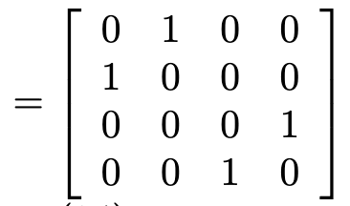
Circuits with Linear Algebra
How would we use linear algebra to determine the outcome of this circuit:

Slide 75
Circuits with Linear Algebra
How would we use linear algebra to determine the outcome of this circuit:
Let’s test this!

Slide 76
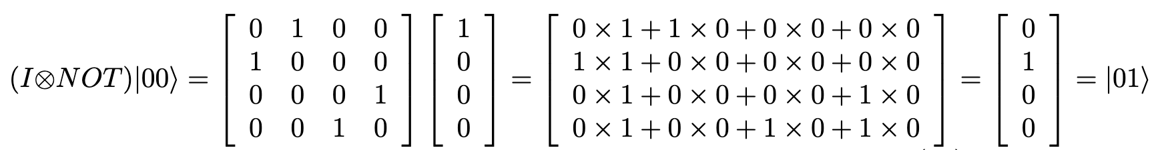
Circuits with Linear Algebra
How would we use linear algebra to determine the outcome of this circuit:
Let’s test this!

Slide 77
Circuits with Linear Algebra
How would we use linear algebra to determine the outcome of this circuit:

Slide 78
Circuits with Linear Algebra
How would we use linear algebra to determine the outcome of this circuit:

Slide 79
Circuits with Linear Algebra
How would we use linear algebra to determine the outcome of this circuit:

Slide 80
Circuits as Matrices
Any circuit can be written as a series of gates. We can use these same basic principles to determine the output of a circuit.
Fortunately, we can use computers to do this math for us! We’ll learn a bit more about how to do that later in the camp.
For now, great job!!!

